Slide 1

Words
Words-as-features as models of cognition. Mitchell et al. 2008

Slide 2
Core questions: neuroscience
Are there systematic differences in neural activity as people think about different concepts?
Is the neural representation of concepts localized in specific brain areas or is it distributed across the entire cortex?
How meaningful are individual differences, or is the representation of meaning similar across people

Slide 3
Core questions: AI / NLP
Can fMRI and neuroscience allow us to ‘test’ or ‘understand’ what are the basis functions (the semantic feature space) that underlies the representation of words?
If so: demonstration of “empirical NLP”; use behavior to guide construction of more cognitive real computational models.

Slide 4
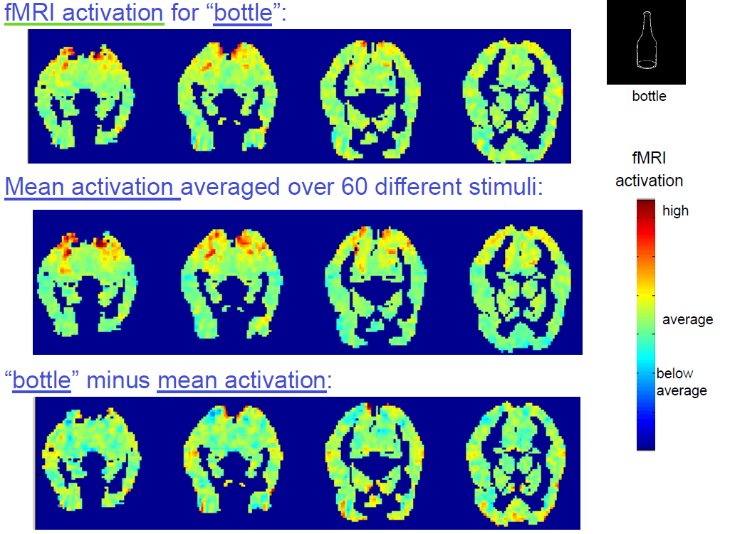
Activity for single word

Slide 5
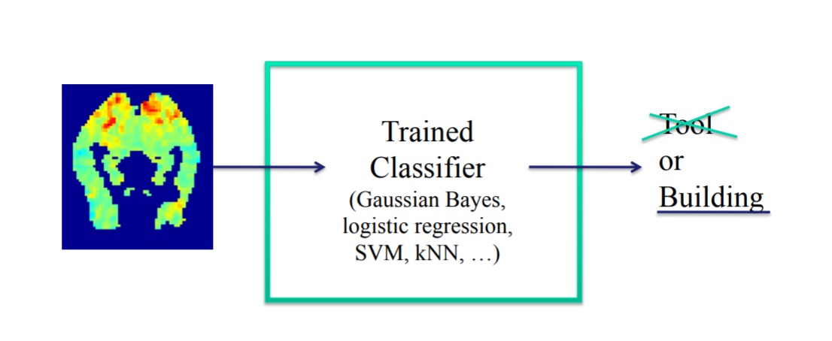
Historical approach (not in paper)
Present multiple words sampled from several categories (e.g., Tools, Buildings).
Train a classifier that predicts the class (Tool/ Building) from the brain images of the words
The results of classifier can be used as a tool for studying the semantics in the brain

Slide 6
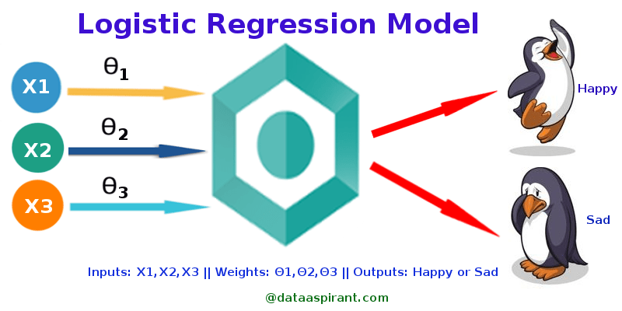
Historical approach (not in paper)
Present multiple words sampled from several categories (e.g., Tools, Buildings).
Train a classifier that predicts the class (Tool/ Building) from the brain images of the words
The results of classifier can be used as a tool for studying the semantics in the brain: e.g., for logistic regression, which voxels have strong weights loading on ‘building’ response
This is a pure ‘decoder’; there is no domain-based knowledge that is applied to predict the brain response from more basic principles

Slide 7
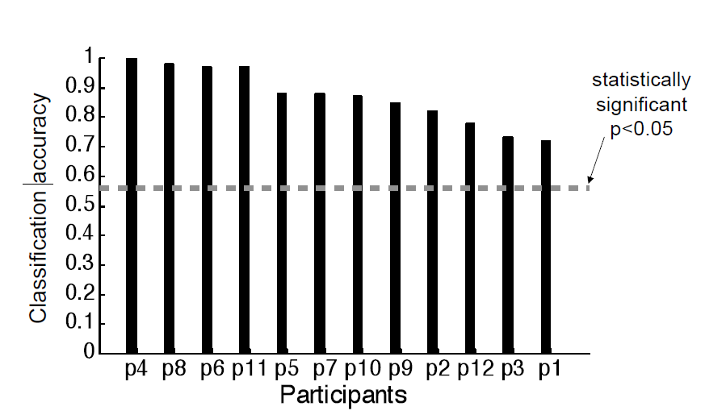
Classification/decoding works: tool or building?
Notes:
By participant results

Slide 8
Classifiers capture some meaning: cross-domain generalization (train on words, guess class of image)
They also have brain activity of: brain activity while Portuguese people watch the same words; people watching images corresponding to the word-set
They now take the results of the classifier trained to discriminate categories based on brain responses to words presented in English and input apply it to those other datasets.
Both ‘Testing on pictures’ and ‘Testing on other language’ produce above chance accuracy
Train weights from responses to English words
Test on brain activity from other domains
Notes:
By participant results

Slide 9
Decoding works, but has a problem
Data are highly dimensional : over 20K features (voxels) per word. But at the same time sparse (only few examples of brain activity per category)
This is difficult from a regression perspective and solutions to this (regularization) are mathematically valid but may lose information about the brain
Requries specialized solutions, “Classification in Very High Dimensional Problems with Handfuls of Examples", M. Palatucci and T. Mitchell, ECML-200

Slide 10
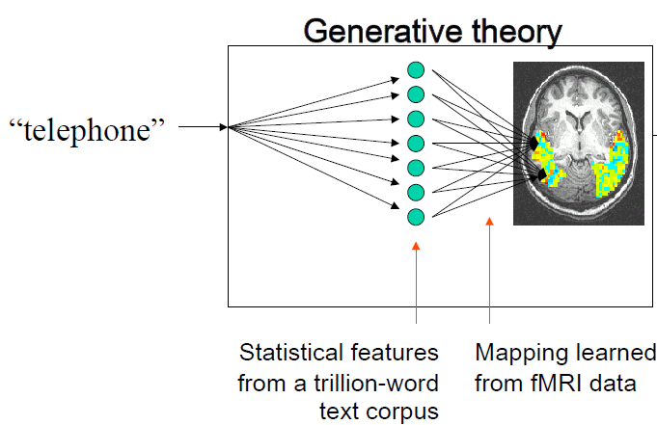
The alternative, a ‘generative’ encoding model
Come up with a theory of word meaning and see whether the theory predicts brain responses
They capture ‘word meaning’ from corpus statistics.
Challenge: find a ‘mapping function’ from word meaning to brain activity

Slide 11
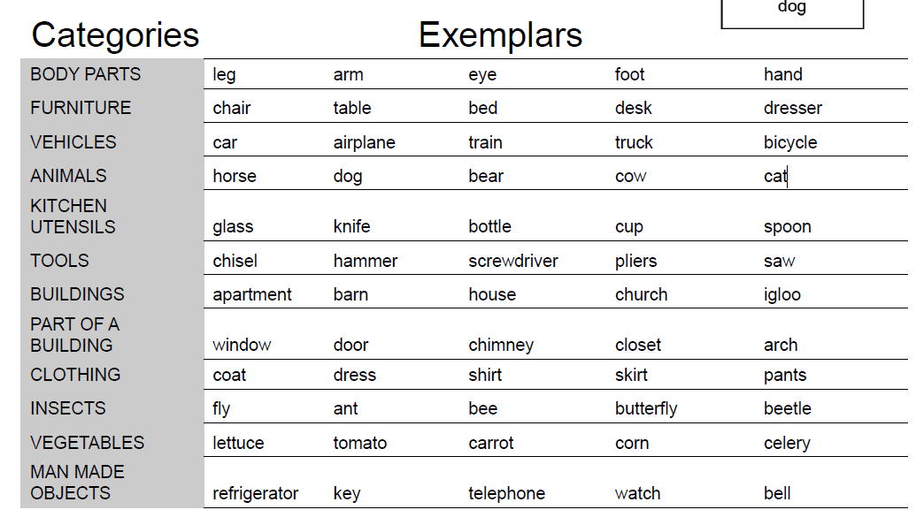
Step 1: decide on how to describe these nouns from corpus statistics.

Slide 12
Step 1: decide on how to describe these nouns from corpus statistics.
Each of their Nouns will be described using 25 features.
Feature i = co-occurrence frequency of stimulus noun with verb i
The model uses 25 verbs:
Sensory: see, hear, listen, taste, touch, smell, fear,
Motor: rub, lift, manipulate, run, push, move, say, eat,
Abstract: fill, open, ride, approach, near, enter, drive, wear, break, clean
Notes:
We can talk about how they decided to use these, but the main point is that each of the 60 nouse is associated with a vector of 25 values

Slide 13
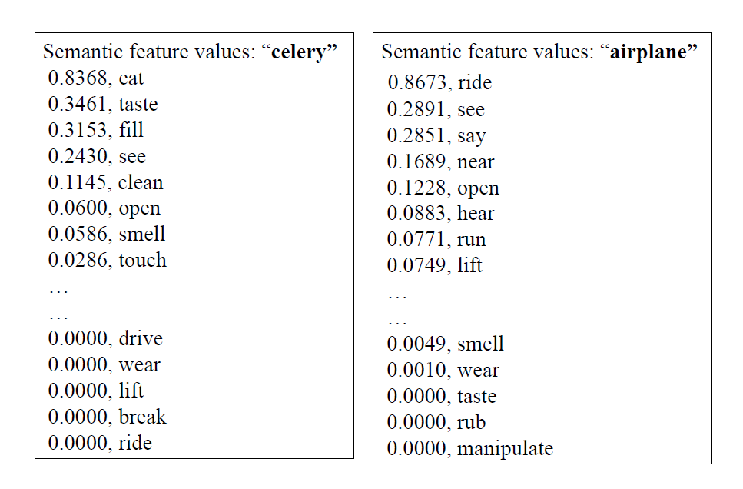

Slide 14
A single-voxel analysis
For each voxel in the brain they learn the relation between voxel activity values for the 60 nouns, and the semantic features of the 60 nouns
“The second step predicts the neural fMRI activation at every voxel location in the brain, as a weighted sum of neural activations contributed by each of the intermediate semantic features.”

Slide 15
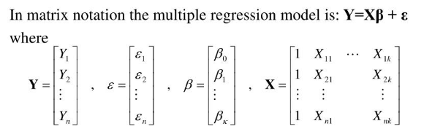
A single-voxel analysis
Activity for 58 nouns in the voxel
Notes:
They leave two out for testing.

Slide 16
A single-voxel analysis
Set of 25 feature-value per noun
Activity for 58 nouns in the voxel

Slide 17
A single-voxel analysis
25 Weights to be fit
Set of 25 feature-value per noun
Activity for 58 nouns in the voxel

Slide 18
What does the single voxel analysis tell us?
For each voxel, what is the relative importance of each of the 25 features!
We can learn this from 59 words and then ‘generate’ a predicted value of voxel activity for the 60th word.

Slide 19
Predicting word activity in a voxel just means multiplying its semantic feature values by learned weights

Slide 20
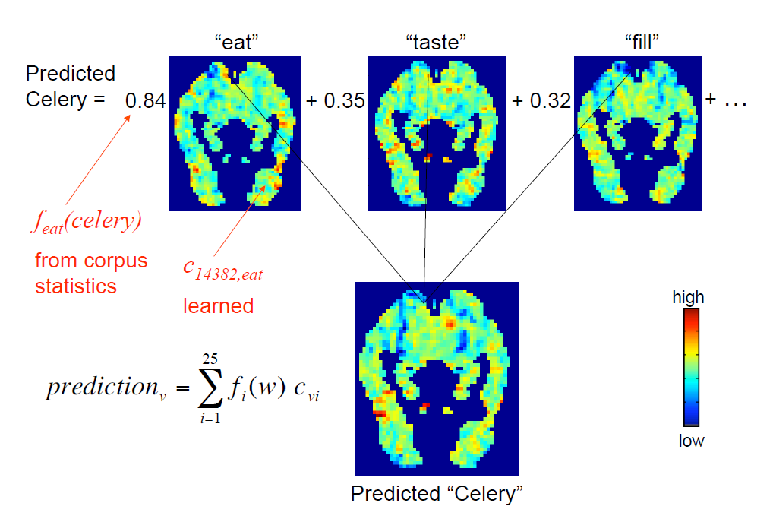
Notes:
C14382, eat is the Weight for EAT learned for that voxel. The prediction is done PER VOXEL (we could have deleted from this image all the voxels not modeled; i.,e kept only the one with the arrow pointing to/from it)

Slide 21
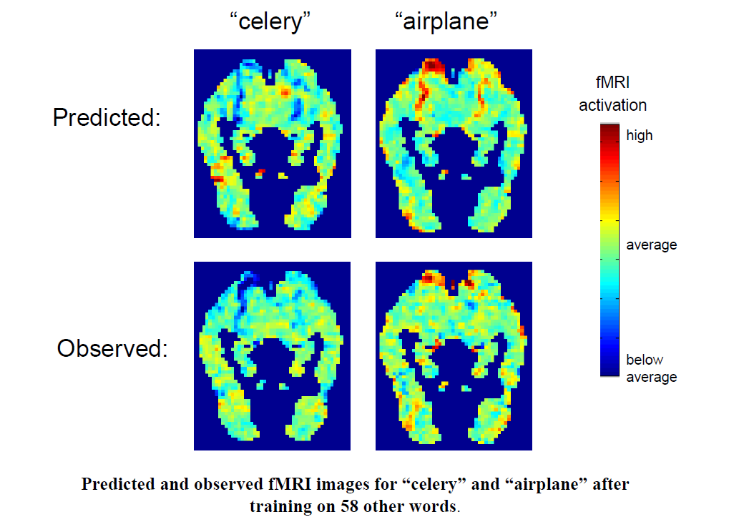
How well does this work?

Slide 22

How do you test the prediction empirically?

Slide 23
A simple two choice test
Predict activity for 2 left out words
From the ‘database’ pull the ‘true’ activity for those two words
See if the predicted activity for word X is more similar to true activity of word X than it is to the other word

Slide 24
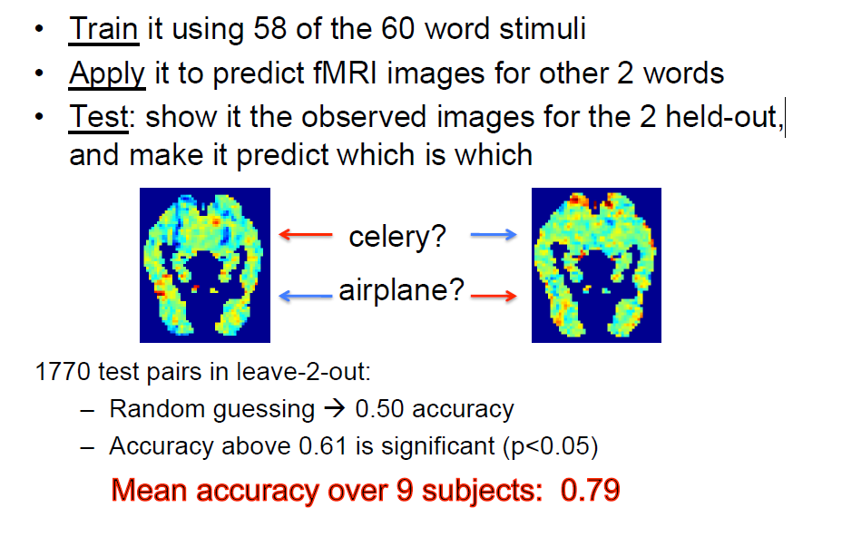
Notes:
The match between the two predicted and the two observed fMRI images was determined by which match had a higher cosine similarity, evaluated over the 500 image voxels with the most stable responses across training presentations (26). ** SO they only use 500 voxels not 20K.

Slide 25
Additional results

Slide 26
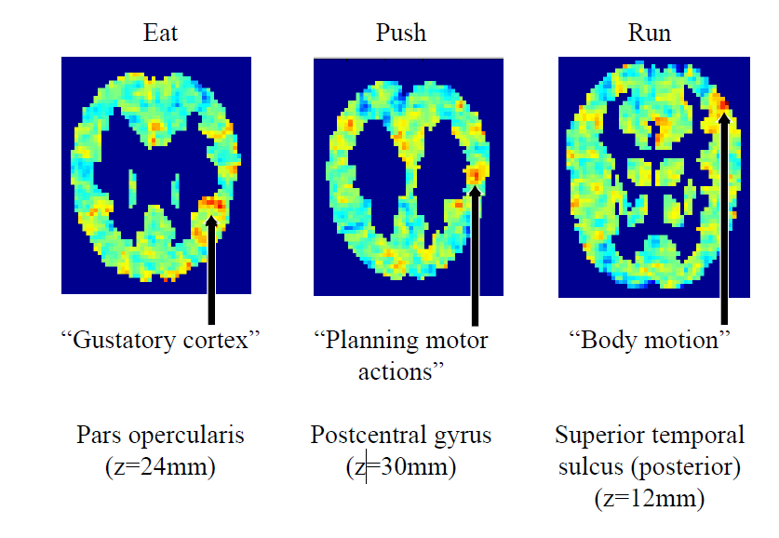
For each of 25 features, examine importance across brain
Notes:
We can ask if the distribution of relative importance of these ‘semantic primitives’ makes sense in relation to what we know about the brain.

Slide 27
For a given participant, which words would be ‘most activating’?
We can split the brain into ‘areas’ and now sweep through a very large number of words (10K) to see which word would maximally activate that region (or, if we wanted, the entire brain)
This is a ‘by participant’ analysis and allows us to account for inter-individual differences.

Slide 28
For a given participant, which words would be ‘most activating’?
Right Opercularis
wheat, beans, fruit, meat, paxil, pie, mills, bread, homework, eve, potatoes, drink (gustatory cortext [Kobayakawa, 2005])
Right Superior Posterior Temporal lobe?
sticks, fingers, chicken, foot, tongue, rope, sauce, nose, breasts, neck, hand, rail (biological motion [Saxe et al., 2004])
Left Anterior Cingulate
poison, lovers, galaxy, harvest, sin, hindu, rays, thai, tragedy, danger, chaos, mortality (emotional stimuli [Gotlib et al, 2005])

Slide 29
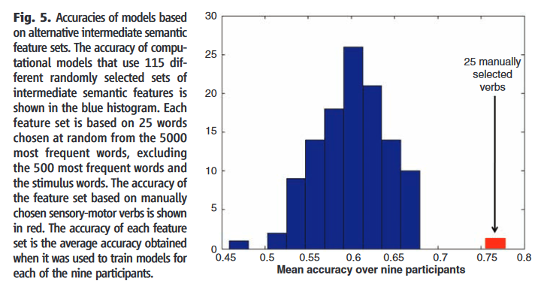
Alternatives to the 25-feature basis set
Would any random basis set work equally well? NO. Choosing 25 words randomly as basis sets always does worse than their manually chosen set.

